Slide 1

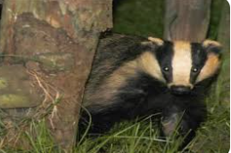
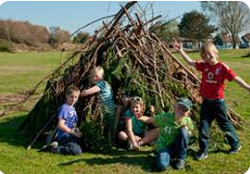
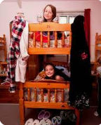
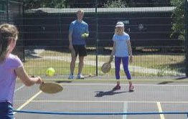
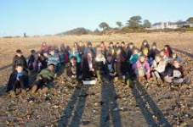
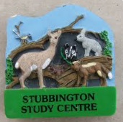
Year 5 Stubbington Residential 2025

Slide 2
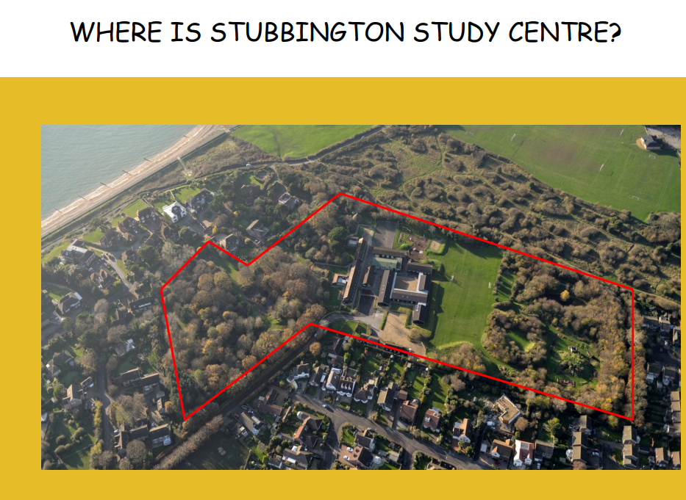
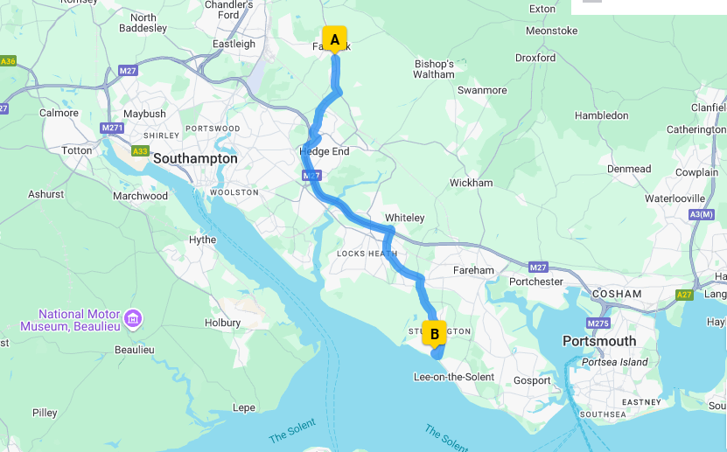
Click here for video

Slide 3
Monday 24th – Wednesday 26th February
Peake and Valentina
Wednesday 26th – Friday 28th February
Sharman, Johnson and Jemison
Both groups will be ready to pick up at 2pm on their last day from the school hall.

Slide 4
The Day of departure
Children should arrive (non-uniform) at the normal time and drop off their luggage (which needs to be labelled with your child’s name and class) in the hall. You should enter via the year 6 gate.
Any medicine that needs to be taken needs to be in a separate bag fully labelled with their name and class. It should also contain directions for the medicine. There will be a member of staff on-hand to receive it. Please make sure you (not your child) hands it to the member of staff.
We will leave the school site at 9.20 on coaches.

Slide 5
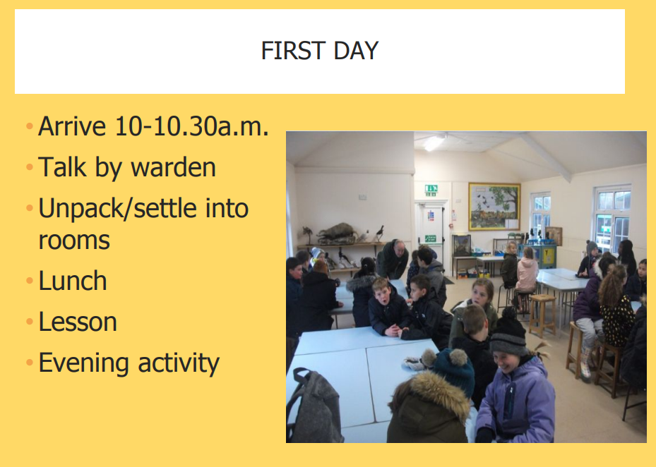
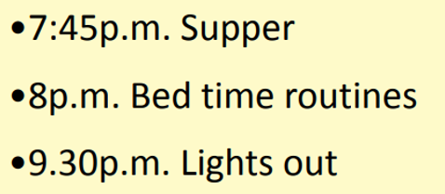

Slide 6
Accommodation
The children will be sleeping in centrally
Heated rooms.
There are 4 – 6 beds in each room.
Each room has their own shower room.
No hairdryers – long hair will need to be towel dried (maybe bring shower caps).

Slide 7
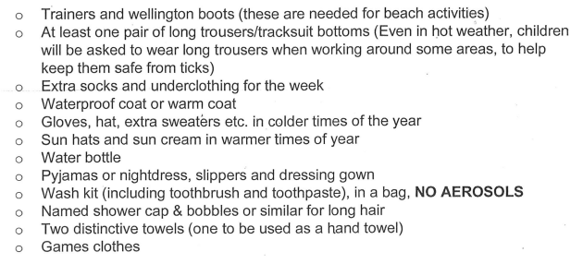
What they’ll need to bring
The main purpose of the visit is to study the outdoors and the environment so they will spend a large part of their time outdoors. They will need the following:

Slide 8
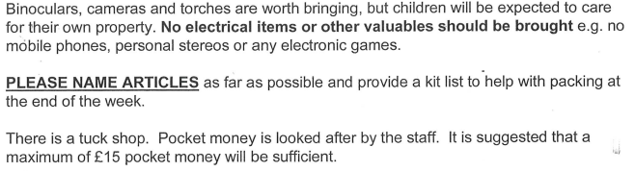
Please do not include (hide or smuggle) any snacks or drinks in your children’s luggage.
This is to ensure we have no issues with possible allergies!

Slide 9
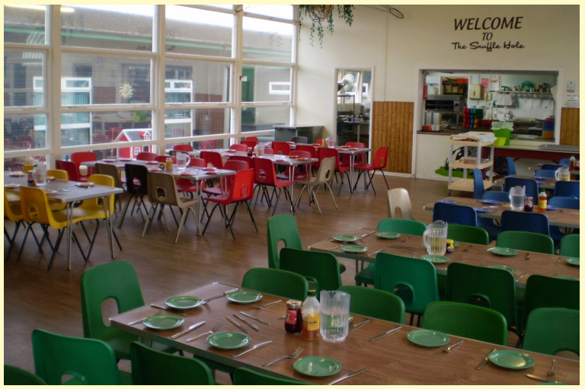
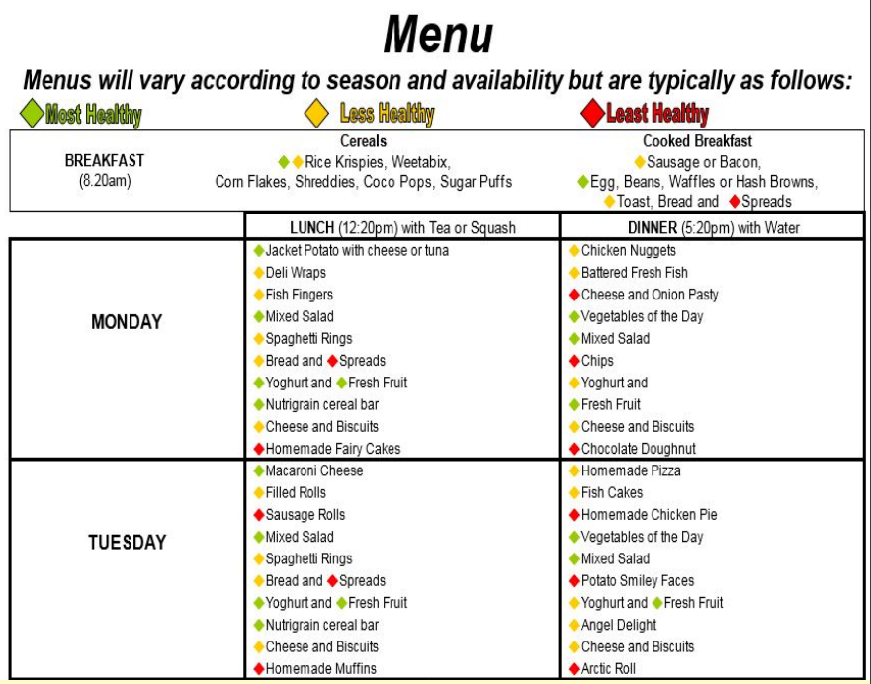

Slide 10
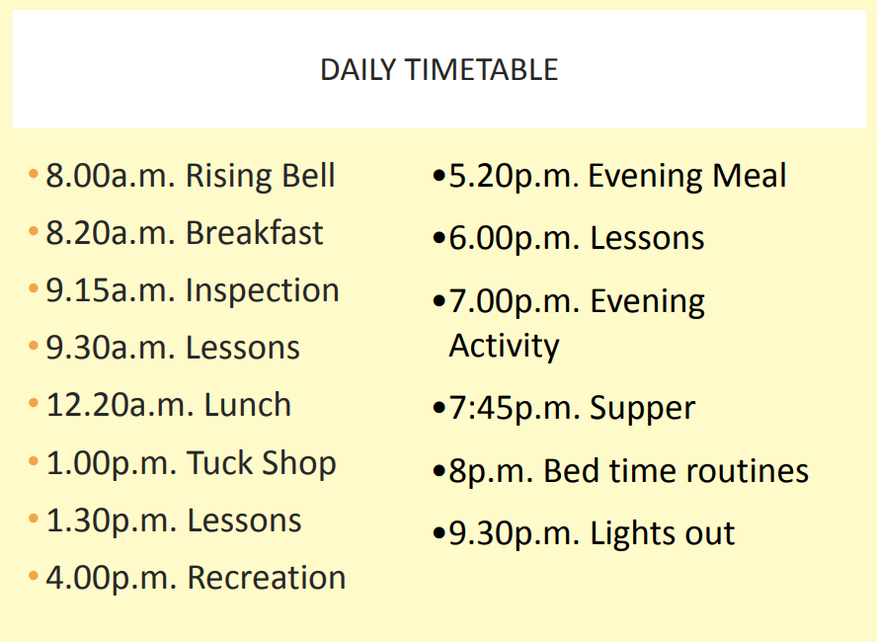


Slide 11
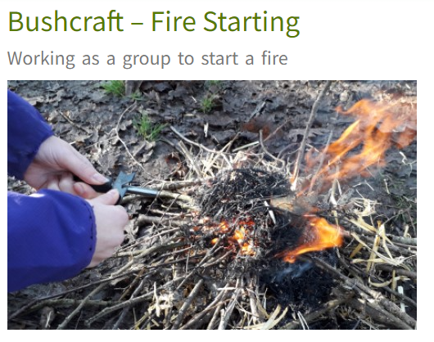
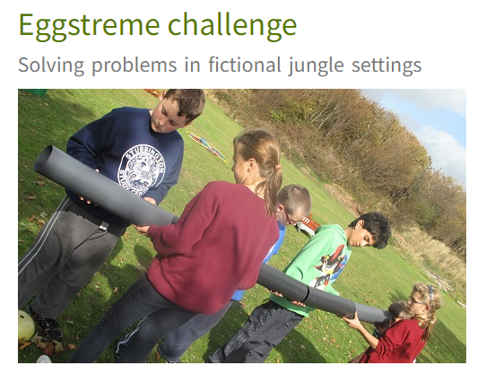
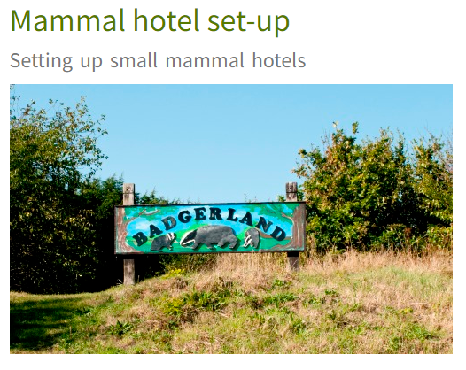
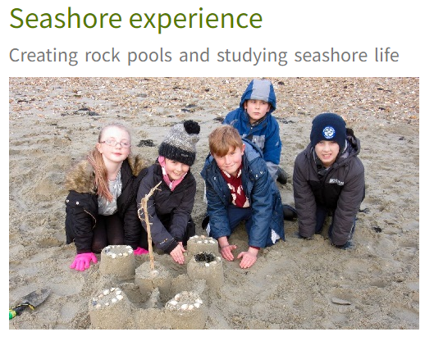
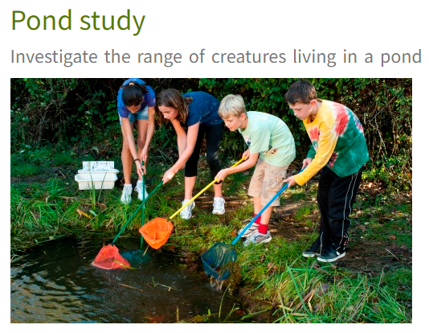
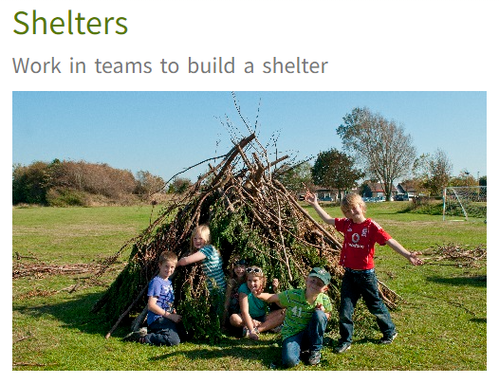

Slide 12
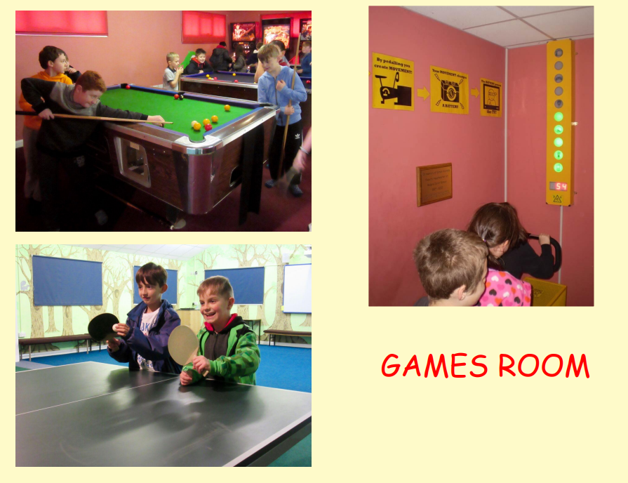
We will also be setting up an Instagram/Facebook
account so you can see all the wonderful things your
children will be doing.
There will be no phone calls home.

Slide 13


